Slide 1

Advance Wireless Notice Board
Presenters
Rushikesh Belekar
Makarand Khadakban
Rahul Shinde
Guided By
Prof. Aniruddha Palsodkar

Slide 2
Contents
Introduction
Problem Statement
Literature Survey
Requirements & Analysis
Flow Chart
Flow Diagram
Pinout Diagram
Advantages
Future Scope
Conclusion

Slide 3
Introduction
At present, All Electronic Boards are designed with a wired system.
To overcome this problem, a Wireless Board is designed to display the information.
This notice board displays the information on Dot Matrix display whatever you sent from the Mobile App.

Slide 4
Problem Statement
Nowadays conveying messages, at large using notice boards, are widely used ones ranging from schools to organizations.
We know the significance of notice boards in public areas like bus stands, railway stations, airports and banks, etc. But changing these boards daily is a very difficult task and a waste of time.
At present, all electronic boards are designed with a wired system. The major drawback of designing these boards is they are not flexible and cannot be located anywhere we want due to messy wires these boards have.

Slide 5
Literature Survey
GSM Based Wireless Notice Board.(March 2016) Prof. Ravindra Joshi, Abhishek Gupta, Rani Borkar, Samita Gawas, Sarang Joshi.
This paper describes the design and construction of E-notice board using GSM technology.
The operation of the system is centered on Raspberry pi Board.

Slide 6
Requirements & Analysis
Hardware Requirements
- Raspberry Pi 4
- Dot Matrix Displays
- Connecting Wires
- Buzzer
Software Requirements
- Android Studio
- Pi OS

Slide 7
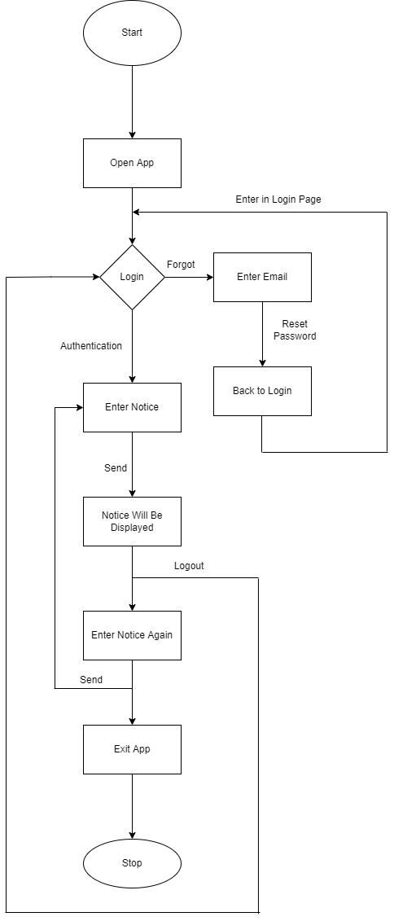
Flowchart
Fig. App Interface

Slide 8
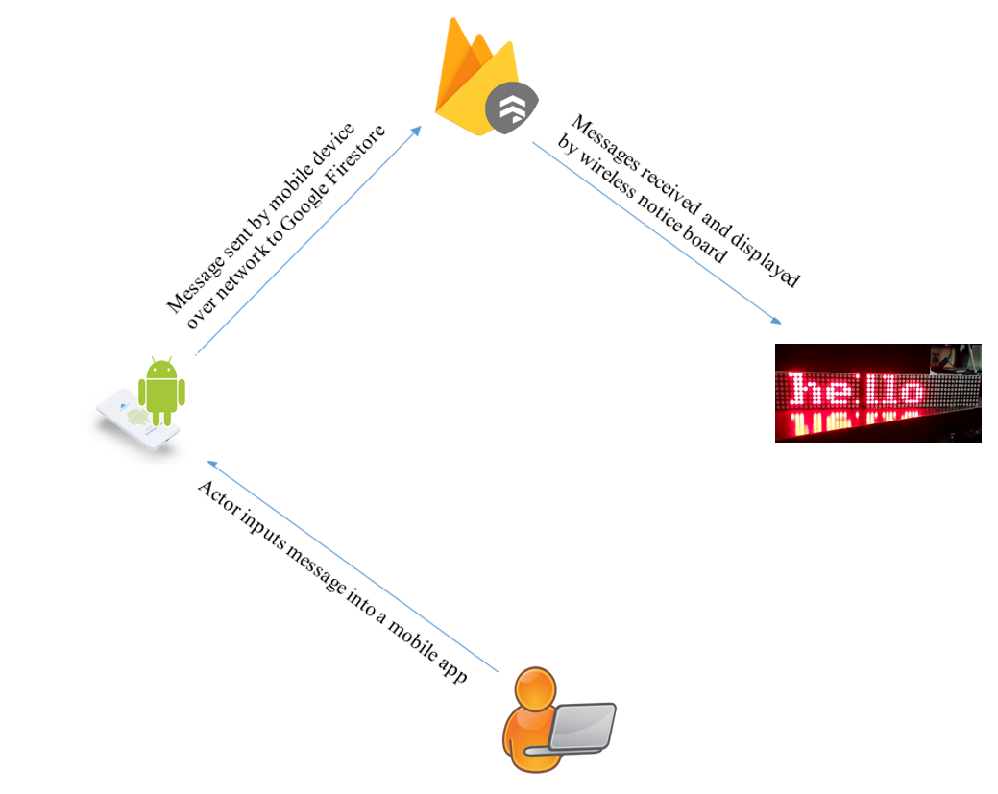
Flow Diagram
Fig. Block Diagram

Slide 9
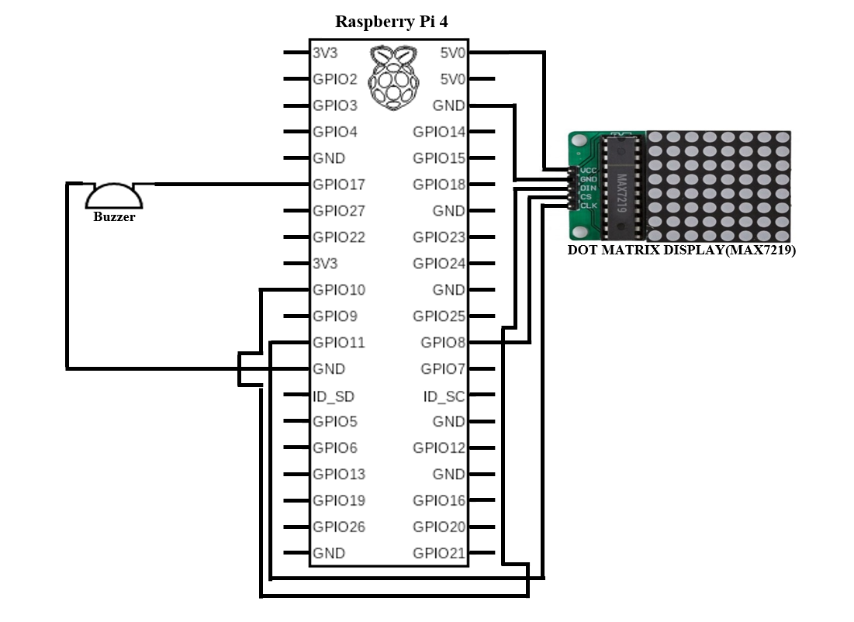
Pinout Diagram

Slide 10
Advantages
Cost efficient
Portable
Wireless
Easy to install
Very good readiness
User friendly UI
Security
Fast

Slide 11
Future Scope
Text-To-Speech
Large Display
More User Friendly UI
Multiple Display Support

Slide 12
Conclusion
Wireless operation provides fast transmission over long range communication.
It saves resources and time.
Data can be sent from remote location.
It is secured as it uses authentication.

Slide 13
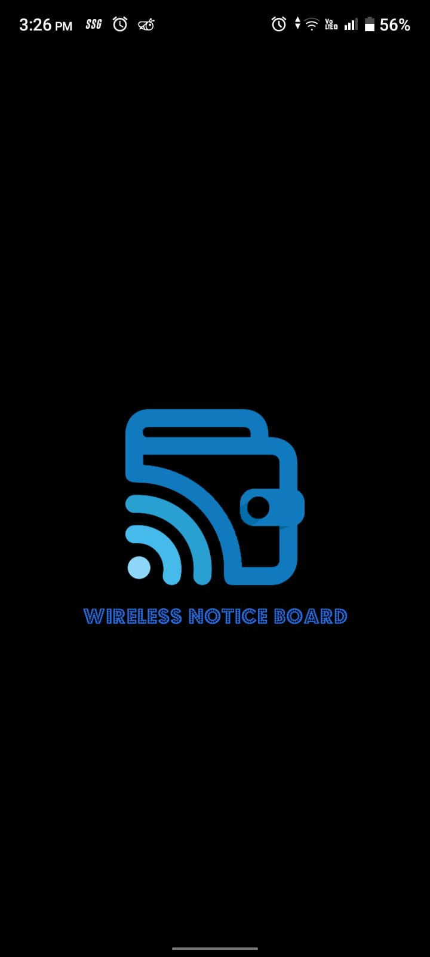
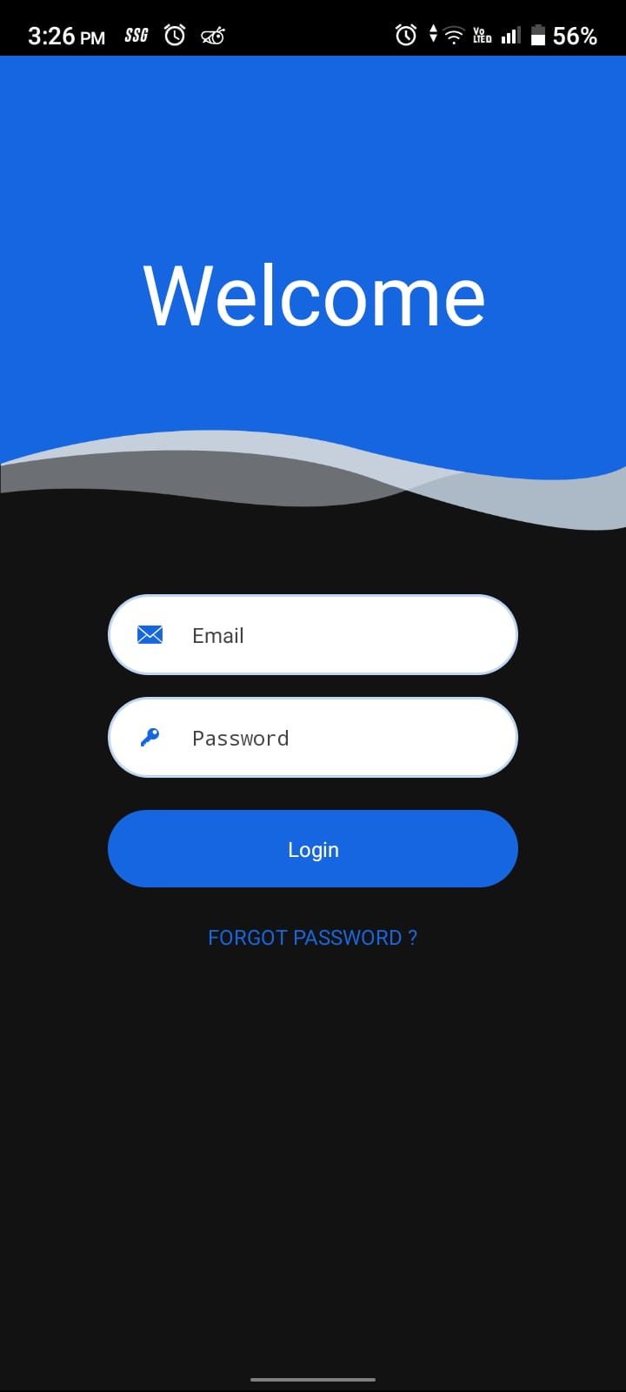
App Interface

Slide 14
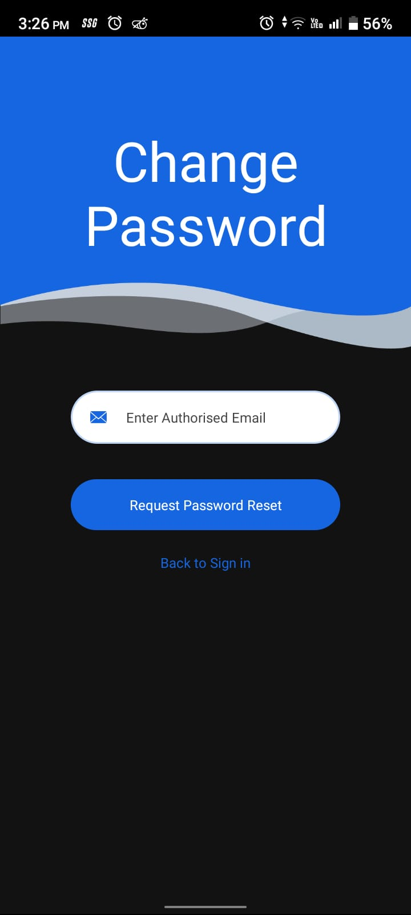
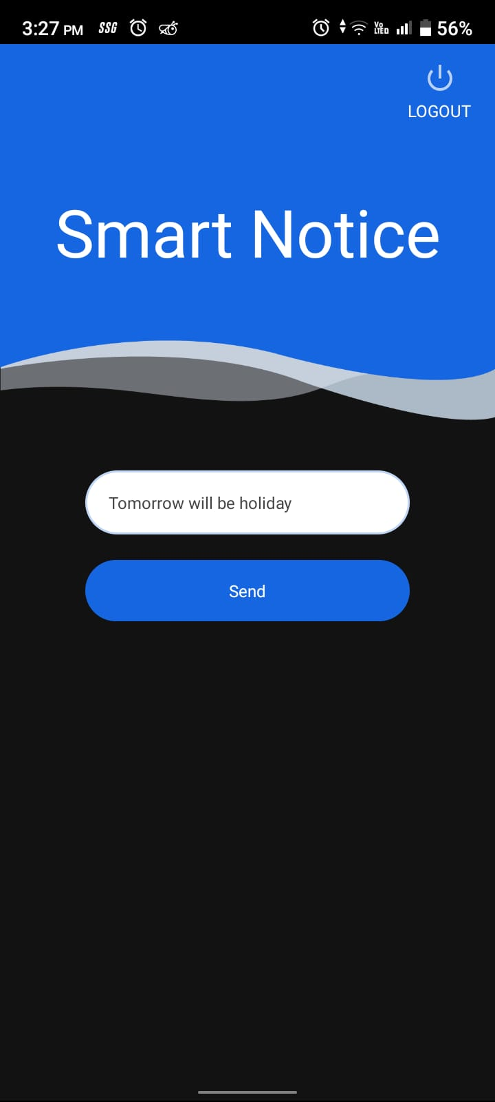
App Interface

Slide 15
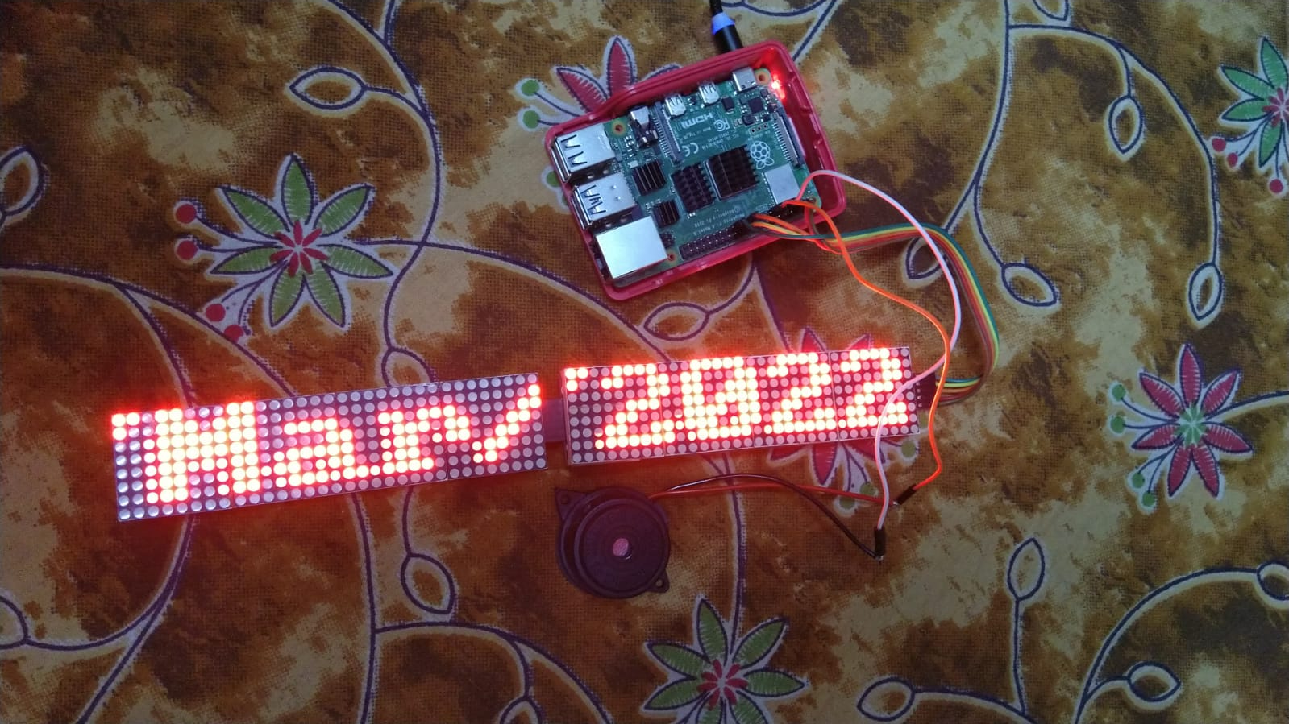
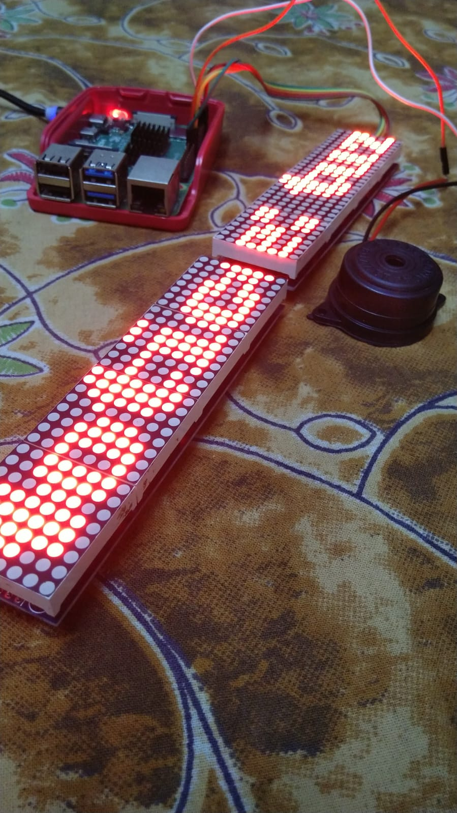
Notice Board

Slide 16
Thank You

